Slide 1
Dynamic Analysis for Security “How do you like them apples?” – Will Hunting
Giovanni Vigna
UCSB
Fall 2024

Slide 2
Dynamic Analysis
Dynamic analysis approaches examine a target during execution
The approaches are specific to environment and compiled target
An input is given to the target and meta-information about the target’s execution guides the analysis
Advantage: When finding a vulnerability, they provide an input that demonstrates the vulnerability
Disadvantage: They do not provide any guarantees about the absence of a vulnerability

Slide 3
Examples of Dynamic Analysis Techniques
Dynamic taint tracking
Invariant inference
Fuzzing

Slide 4
Fuzzing
Fuzzing is an automated procedure to send inputs and record safety condition violations as crashes
Assumption: crashes are potentially exploitable
Several dimensions in the fuzzing space
How to supply inputs to the program under test?
How to generate inputs?
How to generate more "relevant" crashes?
How to change inputs between runs?
Goal: maximized effectiveness of the process

Slide 5





Fuzzing
Bugs (0-day)
Application Under Analysis
Input Generator
Crash
Crash
Database
Fuzzing
Infrastructure
Notes:
Some subset of bugs are exploitable
Some subset are unknown
Goal is to maximize coverage and efficiency of search

Slide 6
Feeding the Beast
The dynamic analysis of targets requires providing test inputs
The type of target defines how input can be passed
Firmware
Kernel
Library
User program
Web application
Network service
Smart contract

Slide 7
Harnesses
Harnesses are programs that “wrap” a target and provide a (somewhat) standardized interface
When invoked with a specific input, the harness translates the input into an invocation of the target
Fuzzing tools and frameworks provide specification for specific harnesses

Slide 8
Sanitizers
Sanitizers are dynamic analysis tools that detect and report runtime bugs in programs by monitoring program behavior during execution
Memory errors: Buffer overflows, use-after-free, memory leaks
Undefined behavior: Integer overflows, division by zero, null pointer dereferencing
Threading issues: Data races, deadlocks.
Sanitizers are runtime checks introduced at compile time
When triggered, they halt execution or log detailed error information when an issue is detected
Examples of Popular Sanitizers:
AddressSanitizer (ASan): Detects memory issues
UndefinedBehaviorSanitizer (UBSan): Catches undefined behavior
MemorySanitizer (MSan): Detects use of uninitialized memory
ThreadSanitizer (TSan): Identifies threading issues

Slide 9
Crash Triage
Test engineers must decide which crashes are interesting and should be investigated
However, there are usually thousands of crashes to consider
Common bucketing technique is to compute stack hashes
Record top k return addresses from crash stack
Hash return addresses to derive crash key
Store crash states grouped by key

Slide 10
Input Generation
Inputs to programs under test depend on the program
Files, network, environment
Input generation strategies
Random data
Mutated data
Data generated from a grammar

Slide 11
Random Inputs
Inputs generated randomly
See B.P. Miller, L. Fredriksen, and B. So, “An Empirical Study of the Reliability of UNIX Utilities,” CACM, 1990
Easy to write, many tools available, works well for (pathologically) buggy programs
Many disadvantages
More crash analysis required
More duplication of results
Will not trigger hard-to-reach bugs

Slide 12
Random Fuzzing

Slide 13
Random Fuzzing
Input Parsing

Slide 14
Random Fuzzing
Input Parsing
Actual Computation

Slide 15
Random Fuzzing
Input Parsing
Actual Computation

Slide 16
Random Fuzzing
Input Parsing
Actual Computation

Slide 17
Mutational Fuzzing
Goal: Instead of generating purely random inputs, mutate inputs that are known to be good
Assign each bit in an input seed an index
Select a (small) sample of indices
Flip those bits in the input and run the program
Repeat
Notes:
How is this better? Mutated inputs are much more likely to be valid inputs that pass the parsing/validation stage
Why is l << n? Many modifications make it more likely to not parse

Slide 18
Mutational Fuzzing
Input Parsing
Actual Computation

Slide 19
Mutational Fuzzing
Input Parsing
Actual Computation

Slide 20
Mutational Fuzzing
Input Parsing
Actual Computation

Slide 21
Mutational Fuzzing
Input Parsing
Actual Computation

Slide 22
Generative Fuzzing
Goal: Construct a grammar that produces “reasonable” inputs, and sample from the corresponding input space
Another approach to exploring program beyond initial parsing and validation stages
However, requires understanding the input space and constructing a grammar
More up-front work compared to random or mutational fuzzing
Not certain that grammar can trigger bugs

Slide 23
(Black-box) Input Generation
Random and mutational fuzzing can get caught in "shallow" code (primarily random)
Even with grammar-based fuzzing it is not clear how deep the test is reaching into the functionality of the program
Notes:
Mutation ratio: number of bits to flip vs. total bits in input seed
In black-box space, mutational fuzzing is most used

Slide 24
Gray/White-box Fuzzing
Goal: Incorporate feedback from previous runs (or pre-computation) to guide input generation
Expand coverage of program under test
Simple example: Establish taint relationship between input seed and path constraints
More complicated: Symbolic execution to extract path conditions, invert a constraint, solve for satisfying input

Slide 25
Gray/White-box Fuzzing
Bugs (0-day)
Application Under Analysis
Input Generator
Crash
Crash
Database
Feedback
Fuzzing
Infrastructure
Notes:
Some subset of bugs are exploitable
Some subset are unknown
Goal is to maximize coverage and efficiency of search

Slide 26

American Fuzzy Lop

Slide 27
American Fuzzy Lop
Instrumentation-guided genetic fuzzer developed by Michael Zalewski
The instrumentation collects information at branch points
Supports the generation of inputs that improve coverage
Inputs that bring new paths are considered more interesting and queued for further exploration
Inputs are chosen and mutated
Unique crashes are identified using branch analysis (instead of stack summaries)

Slide 28
AFL Instrumentation
AFL can instrument both source code and binary
Source code: Recompilation using afl-gcc or afl-clang
Binary: Leverages QEMU user-mode
Supports cross-architecture execution: One can fuzz an ARM binary on x86

Slide 29
AFL Execution
To fuzz a program with AFL an input and output directory are defined
The input directory contains data to be provided to the program under analysis
The output directory contains crashes and variations of the input that caused the crashes
The command to run the program on the input is repeated until a crash/hang is detected

Slide 30
Branch Tracking
The instrumentation collects information about which branches are taken
The information is stored in a shared hash table
A branch from a previous location to the current location triggers the instrumentation code: cur_location = <COMPILE_TIME_RANDOM>; shared_mem[cur_location ^ prev_location]++; prev_location = cur_location >> 1;

Slide 31
Branch Tracking
cur_location = <COMPILE_TIME_RANDOM>; shared_mem[cur_location ^ prev_location]++; prev_location = cur_location >> 1;
Note that the index in the hash is a combination of the previous and current location
The size of the shared memory is 64K
Big enough to avoid collisions
Small enough to be fast and fit in memory caches
The shift of the marker for the current location allows for
Distinguishing A->B from B->A
Distinguishing A->A from B->B

Slide 32
Branch Tracking
Branch tracking is a better metric for program exploration than plain basic block coverage
Consider the following cases, where A, B, C, D, E are code blocks:
A -> B -> C -> D -> E (tuples: AB, BC, CD, DE)
A -> B -> D -> C -> E (tuples: AB, BD, DC, CE)
While the same amount of code is covered, different paths are taken

Slide 33
Guiding Exploration
AFL maintains a global map of all the paths observed in all the executions up to the current one
When a mutated input file introduces tuples that were not observed before, the input file is queued for further processing
Inputs that do not generate new transitions, are discarded (even if the sequence has not been seen before)

Slide 34
Example
#1: A -> B -> C -> D -> E
#2: A -> B -> C -> A -> E (C->A, A->E are new)
#3: A -> B -> C -> A -> B -> C -> A -> B -> C -> D -> E (no new tuples)

Slide 35
Counting Branches
AFL keeps track of how many times a certain transition happens for each run
Buckets: 1, 2, 3, 4-7, 8-15, 16-31, 32-127, 128+
If a particular input causes a transition to move between buckets, then the input is deemed interesting and queued for processing
Buckets allow for emphasizing small changes (1 to 2) vs. not-so-relevant changes (67 to 70)
Notes:
Question are historical buckets of all execution kept?

Slide 36
Processing Input
The interesting files (thousands) are added to the input queue
Usually 10-30% from the discovery of new transitions
The rest from changes in the hit count
The input queue is analyzed so that a subset of the (best) files is marked as “favorite”
The files cover all the tuples
The files have lowest latency and size

Slide 37
Prioritizing the Inputs
Choose a tuple from the ones observed so far and put it in a set
Select the input that caused the shortest execution and has the smallest size
Add all the transitions observed for that execution to the set
If the set does not cover all the previously observed transitions, goto 1

Slide 38
Prioritizing the Inputs
If there are new, yet-to-be-fuzzed favorites present in the queue, 99% of non-favored entries will be skipped to get to the favored ones
If there are no new favorites:
If the current non-favored entry was fuzzed before, it will be skipped 95% of the time
If the current non-favored entry was not fuzzed before, the odds of skipping it are 75%
These values are chosen to balance queue cycling and diversity

Slide 39
Fuzzing Strategies
Sequential bit flips with varying lengths and step-overs
Sequential addition and subtraction of small integers
Sequential insertion of known interesting integers (0, 1, INT_MAX, etc.)
Stacked bit flips, insertions, deletions, arithmetic operations, and splicing of different test cases
It is also possible to provide dictionaries of known keywords to help in the fuzzing process

Slide 40
De-Duplicating Crashes
Challenges:
Using the faulting addresses does not allow one to distinguish between different bugs that result in a fault in shared code (e.g., the code of strcmp)
Using stack traces inflates the count of a bug that can be reached through many paths
AFL identifies a crash as unique if
The crash trace includes a tuple not seen in any of the previous crashes
The crash trace is missing a tuple that was always present in earlier faults

Slide 41
AFL++
AFL++ is a fork/improvement of the original AFL
https://github.com/AFLplusplus/AFLplusplus
Introduces a number of new strategies and optimizations
Supports the use of “sanitizers” in addition to crash detection
Provide (better) support for network services, libraries, and GUI programs

Slide 42
Run It
afl-fuzz -i testcase_dir -o findings_dir /path/to/program @@
Output directory contains
Queue
Crashes
Hangs
afl-plot prints nice plots of the explored binary

Slide 43
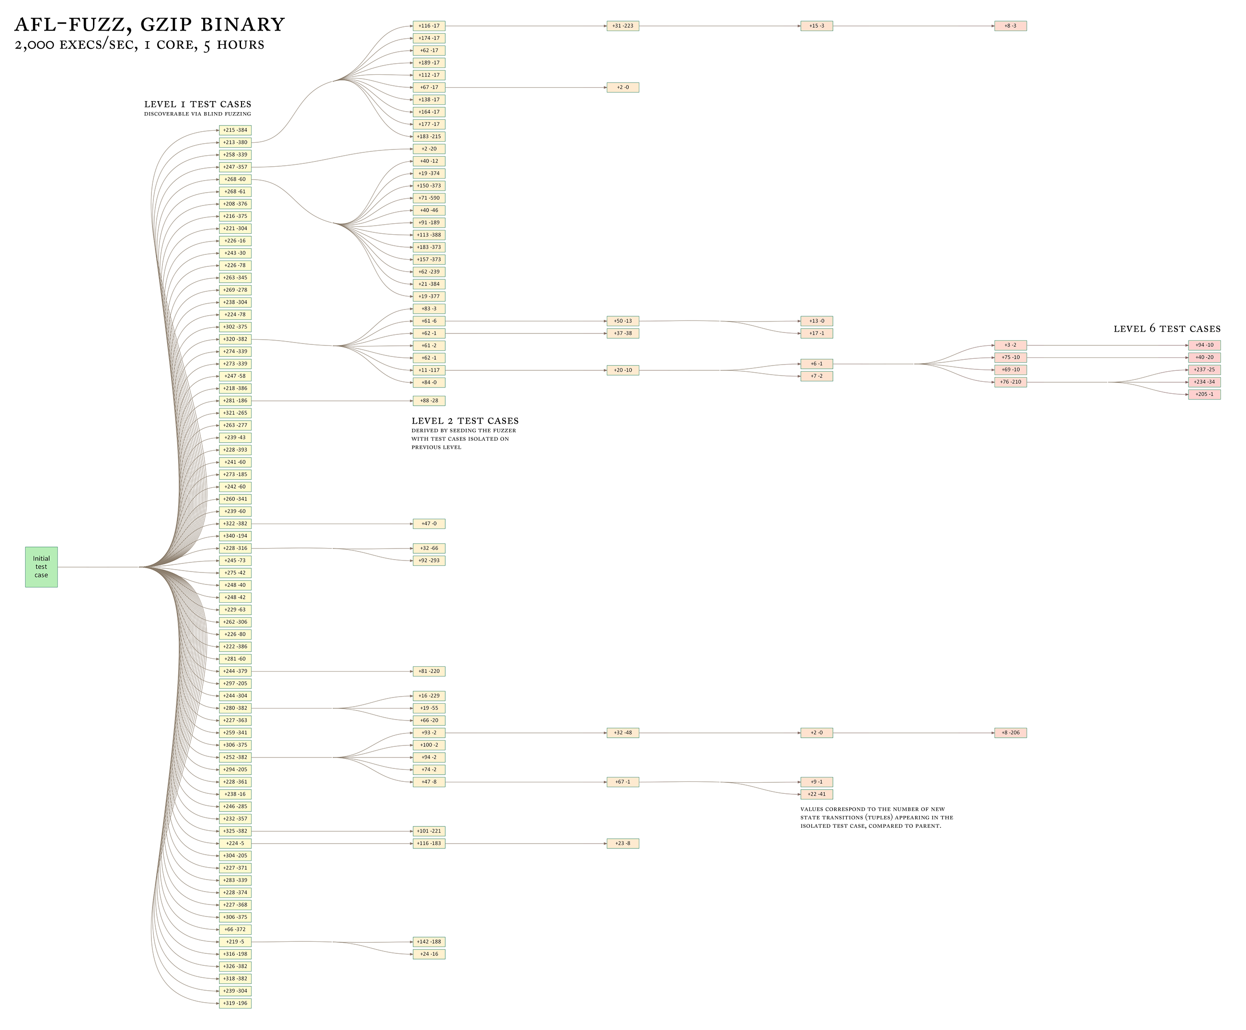
Exploration of Gzip

Slide 44
libFuzzer
libFuzzer is an in-process, coverage-guided, evolutionary fuzzing engine
https://llvm.org/docs/LibFuzzer.html
libFuzzer is linked with the target and receives input in a standardized format, which is translated into invocation to the functions under test
libFuzzer collects coverage information and mutates the input corpus to maximize coverage

Slide 45
angr
Framework for the analysis of binaries
Supports a number of architectures
x86 (32 and 64), MIPS, ARM, PPC, etc.
http://angr.io
https://github.com/angr
angr@lists.cs.ucsb.edu

Slide 46

angr Components
Binary Loader
Control-Flow Graph
angr
Static Analysis Routines
Data-Flow Analysis
Value-Set Analysis
Forward Symbolic Execution
Symbolic Execution Engine
Under-constrained SE

Slide 47
Combining Fuzzing with Symbolic Execution
Dynamic analyses excel at producing general input
Symbolic execution is able to satisfy complex path predicates for specific input
Key insight: Combine both techniques to leverage their strengths and mitigate their weaknesses

Slide 48
int main(void) {
config_t *config = read_config();
if (config == NULL) {
puts("Configuration syntax error");
return 1;
}
if (config->magic != MAGIC_NUMBER) {
puts("Bad magic number");
return 2;
}
initialize(config);
char *directive = config->directives[0];
if (!strcmp(directive, "crashstring")) {
program_bug();
} else if (!strcmp(directive, "set_option")) {
set_option(config->directives[1]);
} else {
do_default();
}
return 0;
}
Notes:
Reads configuration from input
Checks syntax
Checks magic number
Processes directives, one of which has a crash bug

Slide 49
Assisting Fuzzing with Symbolic Execution
Monitors AFL checking for stagnant path discovery
Discovers new paths by symbolically executing AFL’s path queue
Dumps new inputs generated by angr into AFL’s ‘sync’ directory
Responsible for ~20% additional vulnerabilities
AFL
paths discovered through random mutation
paths discovered through symbolic execution
angr

Slide 50
Driller
Test Cases

Slide 51
Driller
Test Cases
“Cheap” fuzzing coverage
“X”
“Y”

Slide 52
Driller
Test Cases
“Cheap” fuzzing coverage
“X”
!
“Y”
Dynamic Symbolic Execution

Slide 53
Driller
Test Cases
“Cheap” fuzzing coverage
“X”
“Y”
Dynamic Symbolic Execution
“MAGIC_VAL1”
New test cases generated

Slide 54
Driller
Test Cases
“Cheap” fuzzing coverage
“X”
“Y”
Dynamic Symbolic Execution
“MAGIC_VAL1”
New test cases generated
“MAGIC_VAL2”

Slide 55
Evaluation
Evaluation performed over CGC qualifying event binaries (self-contained subset of 126)
Three experiments comparing Drilller to fuzzing and concolic execution in isolation
Vulnerabilities discovered
Control transition coverage
Compartment coverage
Notes:
Binaries were analyzed for at most 24 hours each (i.e., 24 hours or a crash is found)

Slide 56
Results
Experiment | Total Vulnerabillities | Unique Vulnerabilities
Fuzzing | 68 | 55
Concolic Execution | 16 | 0
Driller ∪ Fuzzing | 77 | 6
Driller ∩ Fuzzing | 9 | 6
Total | 77 | -
Notes:
Fuzzing = 55 unique, 13 shared w/ concolic, 3 shared w/ driller
Concolic = 16 unique, 0 total
Driller - fuzzing = 6 unique, 3 shared w/ concolic
Driller expands on both fuzzing and concolic execution

Slide 57
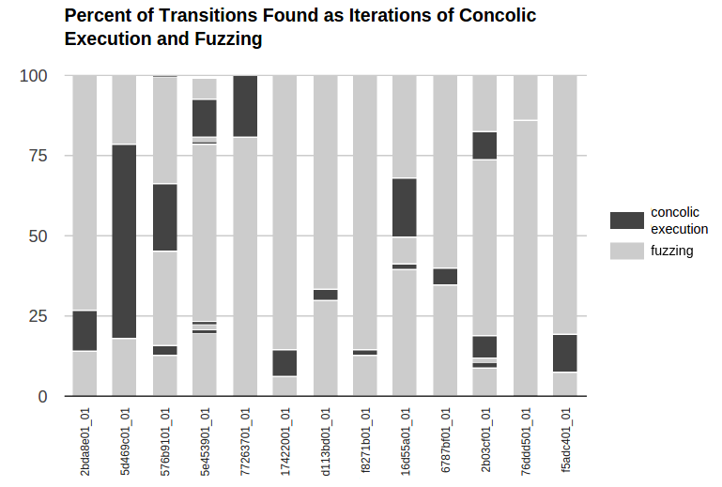
Fuzzing vs. Symbolic Execution
Notes:
Figure shows that targeted concolic execution allows driller to find many transitions that were not found by the fuzzer
In some cases, multiple rounds required

Slide 58
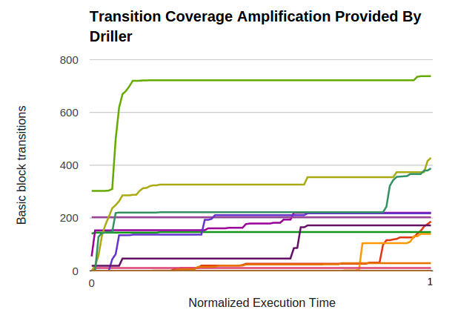
Widening the Coverage

Slide 59
Driller
Combining fuzzing and concolic execution improves vulnerability discovery over either technique in isolation
Selective concolic execution allows fuzzing to efficiently explore otherwise unreachable program compartments
Evaluated over DARPA CGC qualifier data set, discovering 77 crash bugs vs. 68 via fuzzing
Published at NDSS 2016

Slide 60
Exploration Process
Notes:
NRFIN_00017, power testing module
Shows compartments in progressively darker shadings
Fuzzer becomes stuck almost immediately, requiring targeted concolic execution
Stuck because of transitions that require equality with constants that are simple to solve for but must be guessed from a large domain by a fuzzer
Driller eventually able to reach and trigger deep vulnerability due to unsanitized input (successor of D_5)
“Breaking into” 4th compartment was critical to produce crashing trace

Slide 61
OSS-Fuzz
OSS-Fuzz is a Google project to continuously fuzz open-source software
OSS-Fuzz provides support for:
libFuzzer
AFL++
Honggfuzz
Targets can be programs written in C/C++, Rust, Go, Python, Java/JVM, and JavaScript
Supported architectures are x86_64 and i386

Slide 62
Integrating a Project with OSS-Fuzz
Write a number of fuzz targets (see libFuzzer)
Set up the code to be fuzzed in a standard(ish) fashion so that it can be built with different fuzzers and sanitizers
Provide a high-quality seed corpus
Provide a dictionary (if applicable)
Example: https://github.com/google/oss-fuzz/tree/master/projects/example/my-api-repo

Slide 63
Conclusions
Fuzzing is the state-of-the-art in dynamic vulnerability analysis
While powerful, fuzzing can only identify problems in code that it can reach
The composition of fuzzing and static analysis (or symbolic execution) techniques might support effective vulnerability analysis (e.g., concolic execution, directed fuzzing, under-constrained symbolic execution)
You can find all you would ever want to know about fuzzing here: https://www.fuzzingbook.org/

Slide 64


